Slide 1



2022 5th International Conference on Advances in Science and Technology (ICAST)

Slide 2
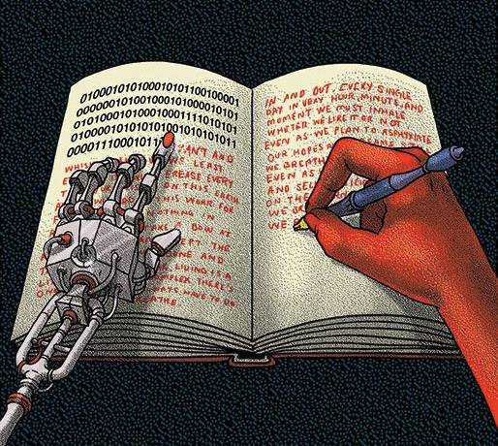
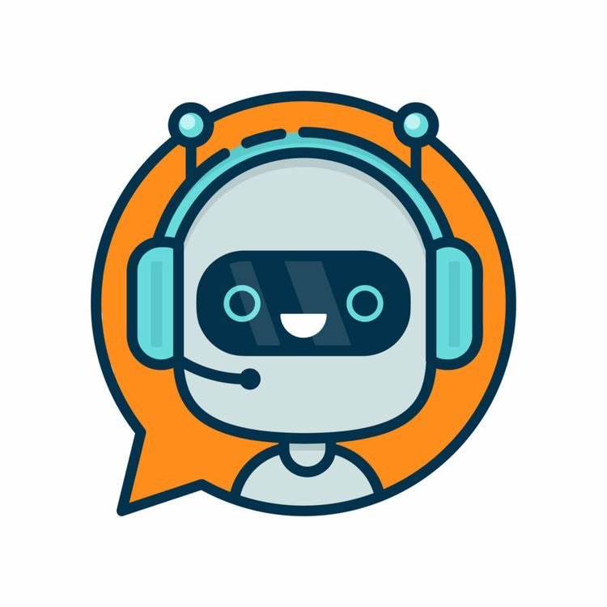
AI driven Chatbot and its Evolution
Authors: Atharvaa Rane, Chinmay Ranade, Hardik Bandekar, Riya Jadhav, Dr. Vidya Chitre
From Vidyalankar Institute of Technology affiliated to Mumbai University

Slide 3
AI driven Chatbot and its Evolution
Index
Abstract
Introduction
Literature Survey
Methodology
Evolution of Chatbots
Comparison Of Metrics
Result
Conclusion
Reference

Slide 4
AI driven Chatbot and its Evolution
Abstract
Traditional systems cannot keep up with the speed and accuracy that humans demand in today's fast-paced world.
The Chatbot responds quickly and less time.
AI with NLP has made it possible for humans and machines to communicate.
There are several types of chatbots created overtime.

Slide 5
AI driven Chatbot and its Evolution
Introduction
Artificial Intelligence (AI) can do numerous tasks related to various sectors.
AI helps in making a faster and better prediction than normal means.
People has always raised questions regarding various sectors for which providing answers can get tedious.
Due to over growing population and increasing demand it is difficult to respond quickly to humans and to overcome this problem chatbot comes in picture which is similar to talking to a human.
An Chatbot addresses these issue in a faster and effective way.
Chatbot is not a recent development it has evolved over the years.
There are two different types of chatbots: Text-based Chatbot and Speech-based Chatbot.

Slide 6
AI driven Chatbot and its Evolution
Literature Survey
University Chatbot using Artificial Intelligence Markup Language is the first university chatbot that uses Pandora bots as an interpreter. It responds quickly and accurately to any user questions for university information in Myanmar Language. [1]
The College Enquiry Chatbot will interact in friendly chats, react to the course and college information, give a link to the tutorial calendar, and answer commonly asked queries. This project focuses on developing a chatbot that students may use to get their questions answered quickly via the college website. [2]
In this article, the publisher conducted a review of several AI-based chatbots, including Eliza, Jabber wacky, Alice Bot, Smarter child, IBM Watson, Siri, Mitsuku, Cortana, Alexa, Tay, Google Assistance, and others. [3]
A chatbot is a piece of computer software that mimics human conversations using voice commands or text messages. This software is recycled to do things like reply quickly to customers, educate them, support them in purchasing things, and deliver better service. The outcomes of an e-commerce chatbot for an online meal ordering service are shown. [4]

Slide 7
AI driven Chatbot and its Evolution
Literature Survey
Letters dominated earlier eras of communication. Then, with the introduction of telephones and, later, mobile phones, the voice took over as the primary mode of communication. However, with the advent of the Internet and other social media platforms, chatbots have taken over the world. As a result of the popularity of chatbots in today's society, it has become a form of communication not only between individuals but also between humans and computers.A chatbot can be beneficial in a number of chatbot services. Applying NLP to user language comprehension and language generation. [5]
Despite having a growing population of over 1.3 billion people, India faces a doctor shortage. Chatbots assist the patient in locating and scheduling appointments with nearby physicians. The program is designed using a mix of NLP and machine learning. [6]
They propose the general operating principle and basic theories of artificial intelligence-based chatbots in this paper. Chatbots can be used in a variety of industries, including telecommunications, finance, health care, call centers, and e-commerce. The chatbot provides a contribution service created for a telecommunications service provider. [7]

Slide 8
AI driven Chatbot and its Evolution
Methodology
The user enters information into the chatbot in the form of a string before the implementation of the chatbot.
Let's take the user's input of "How are you?"
The initial stage after receiving input is the tokenization of words, which involves breaking up words into phrases.
The bag of words step in NLP is the final and most crucial one.
The main issue with text-based learning is that non-standard text formats are frequently used in the documents we need to learn from, like emails.
The Bag of Words study was created to determine the frequency of input words.
The bag of words model is used mainly for information retrieval.
Based on the user's input, it creates a final response with the help of pattern matching.

Slide 9
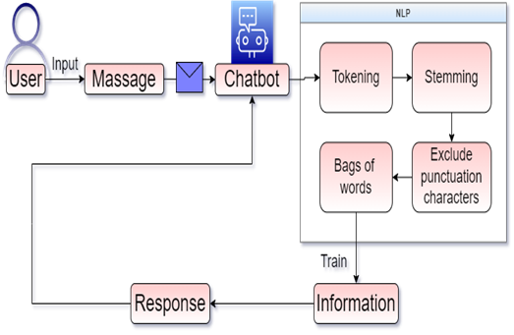
AI driven Chatbot and its Evolution
Methodology
Working of Chatbots

Slide 10
AI driven Chatbot and its Evolution
Evolution of Chatbots
Year | Name | Description
1950 | The Turing Test | This test was the skill of the machine to manifest intelligent behaviour identical to human.
1966 | Eliza | It was the very first chatbot which mimicked human behaviour.
1972 | Parry | Advanced version of Eliza.
1988 | Jabber wacky | The chatbot aimed to have human-like conversations entertainingly.
1991 | Dr. Sbaitos | It is a text-to-speech bot which use sound blaster which was created by creative labs.
1995 | Alice | This heuristic bot as free software for AI markup language.
2001 | Smarter Child | It is the world's first commercial instant messaging bot.

Slide 11
AI driven Chatbot and its Evolution
Evolution of Chatbots
Year | Name | Description
2006 | IBM Watson | IBM Watson uses AI to provide fast, and accurate answers across any application.
2010 | SIRI | It can easily send message, call and do a daily task such as setting your daily reminders, playing music, and also tells the directions.
2014 | Alexa | Virtual voice-based assistance
2016 | Messenger Bots | This messenger bot is present within the messenger applications.
2016 | Google Assistant | It is voice-based chatbot used for daily task and home automation.
2017 | Woebot | It is a free therapy chatbot application that helps for sentiments analysis and treats depression.

Slide 12
AI driven Chatbot and its Evolution
COMPARISON OF METRICS
This table distinguishes between human-to-human, manual systems, and AI-powered chatbots.
The outcomes obtained based on our inference of the experiments are as follows.

Slide 13
AI driven Chatbot and its Evolution
COMPARISON OF METRICS
Sr. No | Metrics | Human-to-Human | Manual System | AI-powered chatbot
1 | Time | Time Bound | Not always available | 24 hours availability
2 | Proactive customer interaction | Sometimes initiating the communication | Not initiating the communication | Initiate the communication
3 | Speed | Time-consuming | Slow | Fast
4 | Capacity of holding data | High | Moderately Low | Low
5 | User Interface | Difficult to approach | Complex | Easy to use
6 | Cost | Expensive | Moderately expensive | Cheap
7 | Keeping up with the trend | Not available on all | Available on e-commerce website | Available on various social media & commercial platforms
8 | Conversation rate | Less | Moderate | High
9 | Learning | High | Less | High

Slide 14
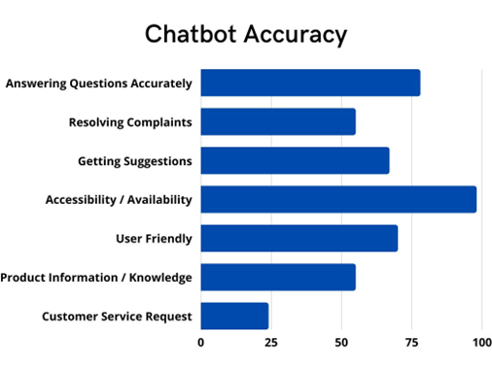
AI driven Chatbot and its Evolution
RESULT
We conducted a survey for our chatbot consisting of the following criteria: answering questions accurately, resolving complaints, getting suggestions, accessibility/availability, user-friendly, product information/knowledge, and customer service requests.

Slide 15
AI driven Chatbot and its Evolution
CONCLUSION
The article primarily focuses on developing a chatbot that can answer numerous FAQs, as well as research, was done on the growth of different chatbots over time.

Slide 16
AI driven Chatbot and its Evolution
REFERENCES
[1] Khin, N. N., & Soe, K. M. (2020). University Chatbot using Artificial Intelligence Markup Language. 2020 IEEE Conference on Computer Applications, ICCA 2020. https://doi.org/10.1109/ICCA49400.2020.9022814
[2] Parkar, R., Payare, Y., Mithari, K., Nambiar, J., & Gupta, J. (2021). AI and Web-Based Interactive College Enquiry Chatbot. Proceedings of the 13th International Conference on Electronics, Computers and Artificial Intelligence, ECAI 2021. https://doi.org/10.1109/ECAI52376.2021.9515065J
[3] Singh, S., & Thakur, H. K. (2020). Survey of Various AI Chatbots Based on Technology Used. ICRITO 2020 - IEEE 8th International Conference on Reliability, Infocom Technologies and Optimization (Trends and Future Directions). https://doi.org/10.1109/ICRITO48877.2020.9197943
[4] Savanur, A., Niranjanamurthy, M., Amulya, M. P., & Dayananda, P. (2021). Application of Chatbot for consumer perspective using Artificial Intelligence. Proceedings of the 6th International Conference on Communication and Electronics Systems, ICCES 2021. https://doi.org/10.1109/ICCES51350.2021.9488990.

Slide 17
AI driven Chatbot and its Evolution
REFERENCES
[5] Tajane, K., Dave, S., Jahagirdar, P., Ghadge, A., & Musale, A. (2018). AI Based Chat-Bot Using Azure Cognitive Services. Proceedings - 2018 4th International Conference on Computing, Communication Control and Automation, ICCUBEA 2018. https://doi.org/10.1109/ICCUBEA.2018.8697737
[6] Pamina, J., S, A., P, A., & Krishna T, J. (2019). Medical Assistant Chat-Bot for Health Care Application. International Journal of Scientific Research in Computer Science, Engineering and Information Technology. https://doi.org/10.32628/cseit195271
[7] Albayrak, N., Ozdemir, A., & Zeydan, E. (2018). An overview of artificial intelligence based chatbots and an example chatbot application. 26th IEEE Signal Processing and Communications Applications Conference, SIU 2018. https://doi.org/10.1109/SIU.2018.8404430.

